Slide 1
Sr 15 section 088 csvt southern section
PUBLIC MEETING
June 16, 2015

Slide 2
SR 15 SECTION 088 CSVT SOUTHERN SECTION
AGENDA
PROJECT HISTORY
NORTHERN SECTION UPDATE
SOUTHERN SECTION OVERVIEW
INTERCHANGES
PROJECT SCHEDULE
UPCOMING ACTIVITIES
OPEN DISCUSSION & GROUP QUESTIONS
ONE-ON-ONE QUESTIONS (OPEN HOUSE)

Slide 3
SR 15 SECTION 088 CSVT SOUTHERN SECTION
PROJECT HISTORY
1994 – Studies initiated
2003 – Final Environmental Impact Statement (FEIS) approved
– Record of Decision issued and project alignment established
2006 – Northern Section final design initiated
2008 – Project placed on hold
2013 – Act 89 passed (funding identified) and project reactivated
2015 – Southern Section final design initiated
– Financial Plan submitted to Federal Highway Administration (FHWA)

Slide 4
SR 15 SECTION 088 CSVT SOUTHERN SECTION
PROJECT PURPOSE (from 2003 FEIS):
Reduce Congestion and Accommodate Growth:
By 2020, traffic is anticipated to more than double on area roadways, and without CSVT, nearly all primary roadways will be congested.
Improve Safety:
6 miles of primary roadways exceed statewide average crash rate, and 8 miles exceed statewide average fatal crash rate.
Separate Trucks and Through Traffic from Local Traffic:
Over 50% of autos and over 90% of trucks pass through project area.
Nearly 50% of accidents involve a truck.

Slide 5
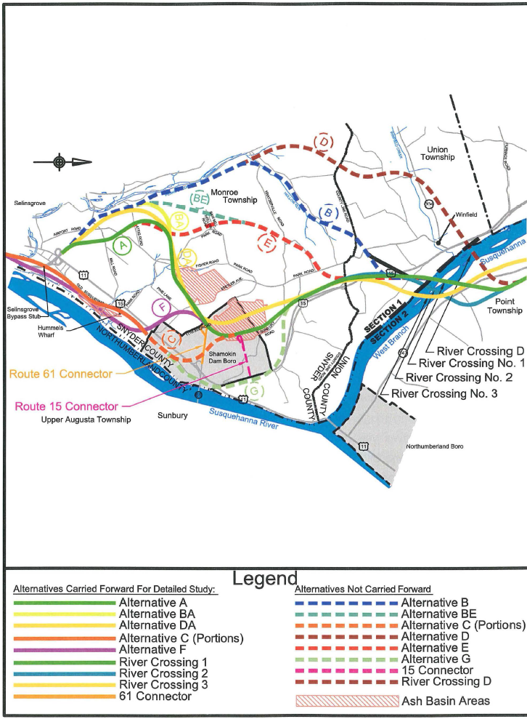
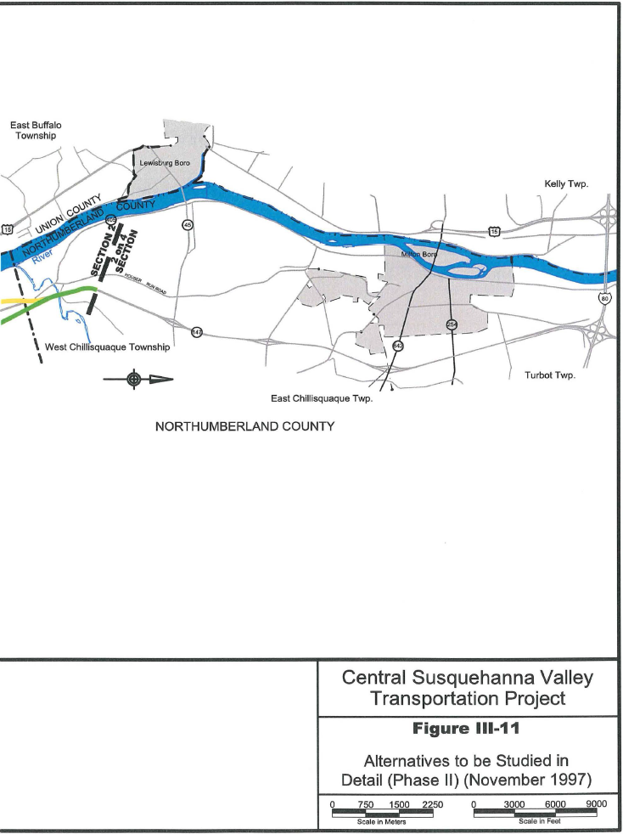
SR 15 SECTION 088 CSVT SOUTHERN SECTION

Slide 6
SR 15, SECTION 088 CSVT SOUTHERN SECTION

Slide 7
SR 15, SECTION 088 CSVT SOUTHERN SECTION
NORTHERN SECTION

Slide 8
SR 15, SECTION 088 CSVT SOUTHERN SECTION
NORTHERN SECTION
 | 2015 |  |  |  |  |  |  |  |  |  |  |  | 2016 |  |  |  |  |  |  |  |  |  |  |  | 2017 |  |  |  |  |  |  |  |  |  |  |  | 2018 |  |  |  |  |  |  |  |  |  |  |  | 2019 |  |  |  |  |  |  |  |  |  |  |  | 2020 |  |  |  |  |  |  |  |  |  |  |  | 2021 |  |  |  |  |  |  |  |  |  |  |  | 2022 |  |  |  |  |  |  |  |  |  |  |  | 2023 |  |  |  |  |  |  |  |  |  |  |  | 2024
 | FINAL DESIGN
 | RIGHT-OF-WAY ACQUISITION
 | UTILITY COORDINATION
 | PERMIT-TING
 | FEIS REEVAL.
 |  |  |  |  |  |  |  | RIVER BRIDGE CONSTRUCTION
 |  |  |  |  |  |  |  |  |  |  |  |  |  |  |  |  |  |  |  | EARTHWORK AND NON-RIVER STRUCTURES CONSTRUCTION
 |  |  |  |  |  |  |  |  |  |  |  |  |  |  |  |  |  |  |  |  |  |  |  |  |  |  |  |  |  |  |  |  |  |  |  |  |  |  |  |  |  |  |  |  |  |  |  |  |  |  |  |  |  |  |  |  |  |  |  |  | PAVEMENT CONSTRUCTION

Slide 9
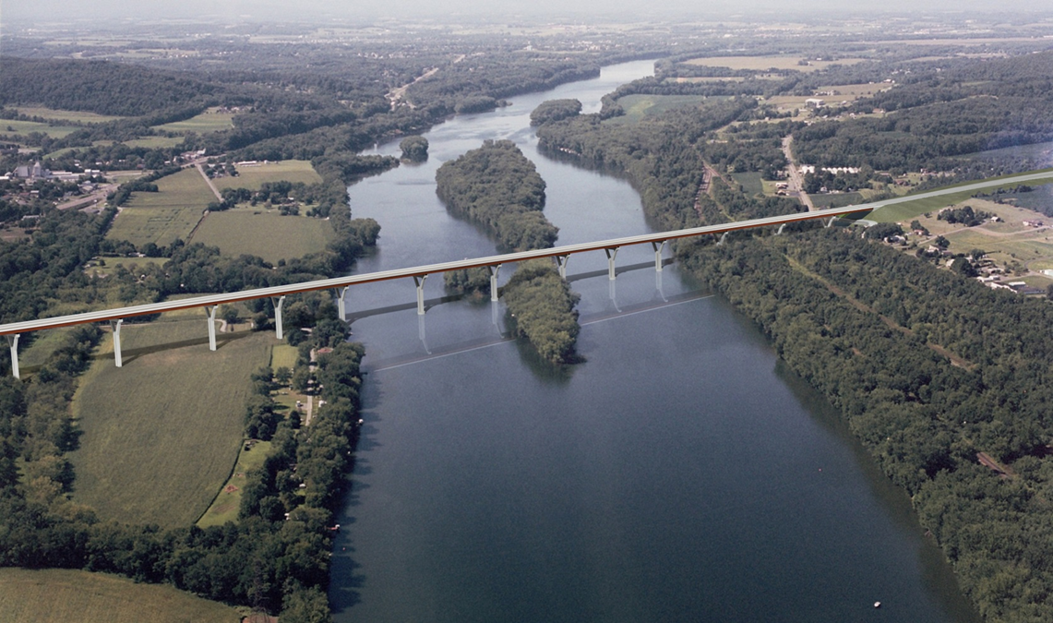
SR 15 SECTION 088 CSVT SOUTHERN SECTION
PROPOSED WEST BRANCH SUSQUEHANNA RIVER BRIDGE

Slide 10
SR 15 SECTION 088 CSVT SOUTHERN SECTION
DESIGN TEAM

Slide 11
SR 15 SECTION 088 CSVT SOUTHERN SECTION
TYPICAL SECTION

Slide 12
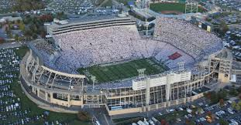
SR 15 SECTION 088 CSVT SOUTHERN SECTION
CSVT QUICK FACTS
7.2 Miles of New Roadway
4.27 Million CY of Excavation
13 New Bridges
319,000 SY of Pavement
Fill Beaver Stadium
over 5 Times
Pave 50 football fields (plus endzones)

Slide 13
SR 15 SECTION 088 CSVT SOUTHERN SECTION
A COUPLE OF NOTES BEFORE WE LOOK AT THE ALIGNMENT…
No major alignment changes anticipated
Design team currently looking at adjustments
Reasons for future adjustments
Embankment, excavation slopes
Minimizing impacts
Improving intersection/interchange efficiency
Making bridges more efficient
Unexpected conditions
Stormwater management development

Slide 14
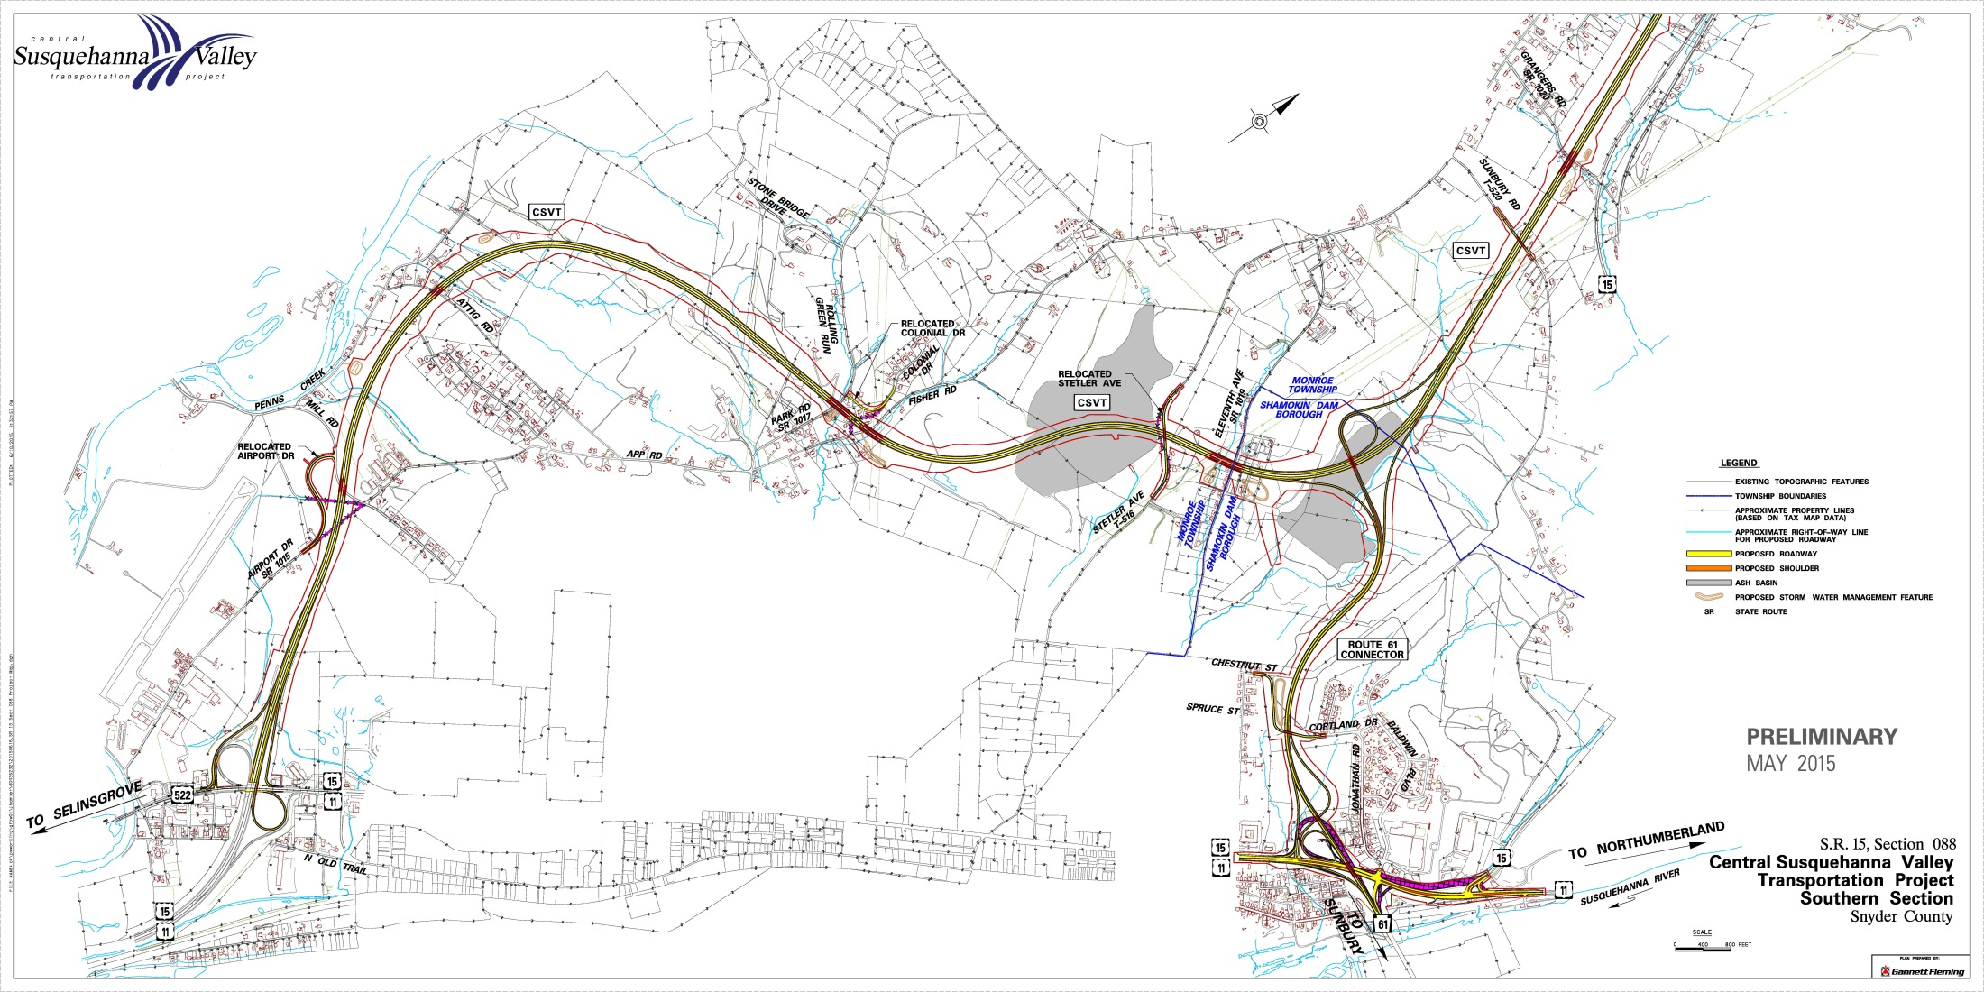
SR 15 SECTION 088 CSVT SOUTHERN SECTION
REVIEW OF CSVT SOUTHERN SECTION

Slide 15
SR 15 SECTION 088 CSVT SOUTHERN SECTION
INTERCHANGES
Selinsgrove Interchange
Route 61 Connector Interchange
Shamokin Dam Interchange

Slide 16
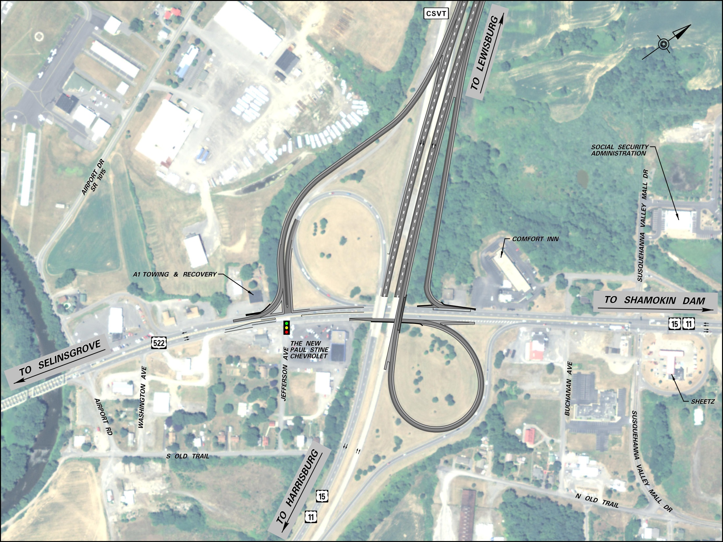
Selinsgrove Interchange
Notes:
Interchange Movements
YELLOW - From Selinsgrove onto 11/15 headed for Harrisburg, today you have to use the jughandle, in the future you’ll be able to turn left onto the ramp.
BLUE - From Selinsgrove onto CSVT headed for Lewisburg.
RED - From Lewisburg on CSVT to Selinsgrove or the Golden Strip.
PINK - From the Golden Strip on 11/15 onto CSVT headed for Lewisburg.
BLACK - From the Golden Strip on 11/15 headed for Harrisburg.
GREEN - From Harrisburg to the Golden Strip, you’ll continue like you do today on this ramp.
ORANGE - From Harrisburg to Selinsgrove, you’ll continue using the same ramp and jug handle you use today.

Slide 17
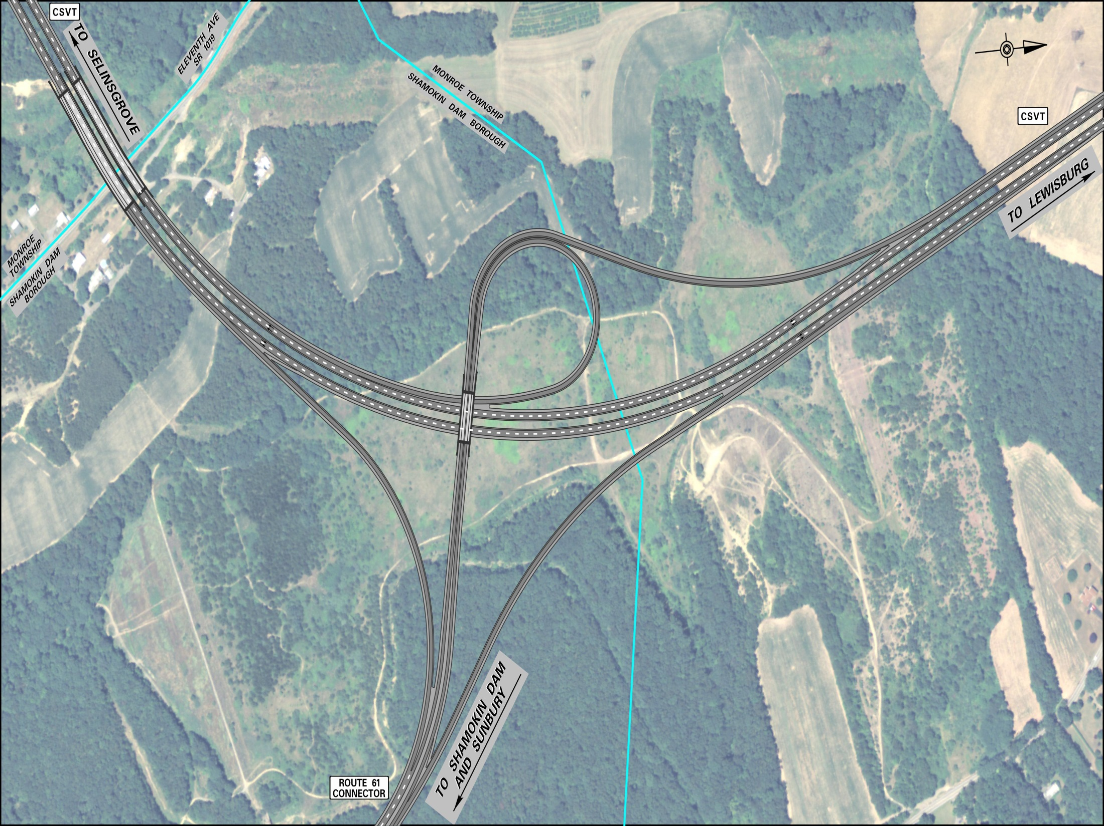
SR-61 Connector Interchange
Notes:
Interchange Movements
BLUE - Starting on CSVT from Selinsgrove headed for Shamokin Dam/61 Connector will use this ramp.
RED - Starting on CSVT from Lewisburg headed for Shamokin Dam/61 Connector
GREEN - From Shamokin Dam on the Route 61 Connector headed for Lewisburg.
YELLOW - From Shamokin Dam on the Route 61 Connector headed for Selinsgrove.

Slide 18
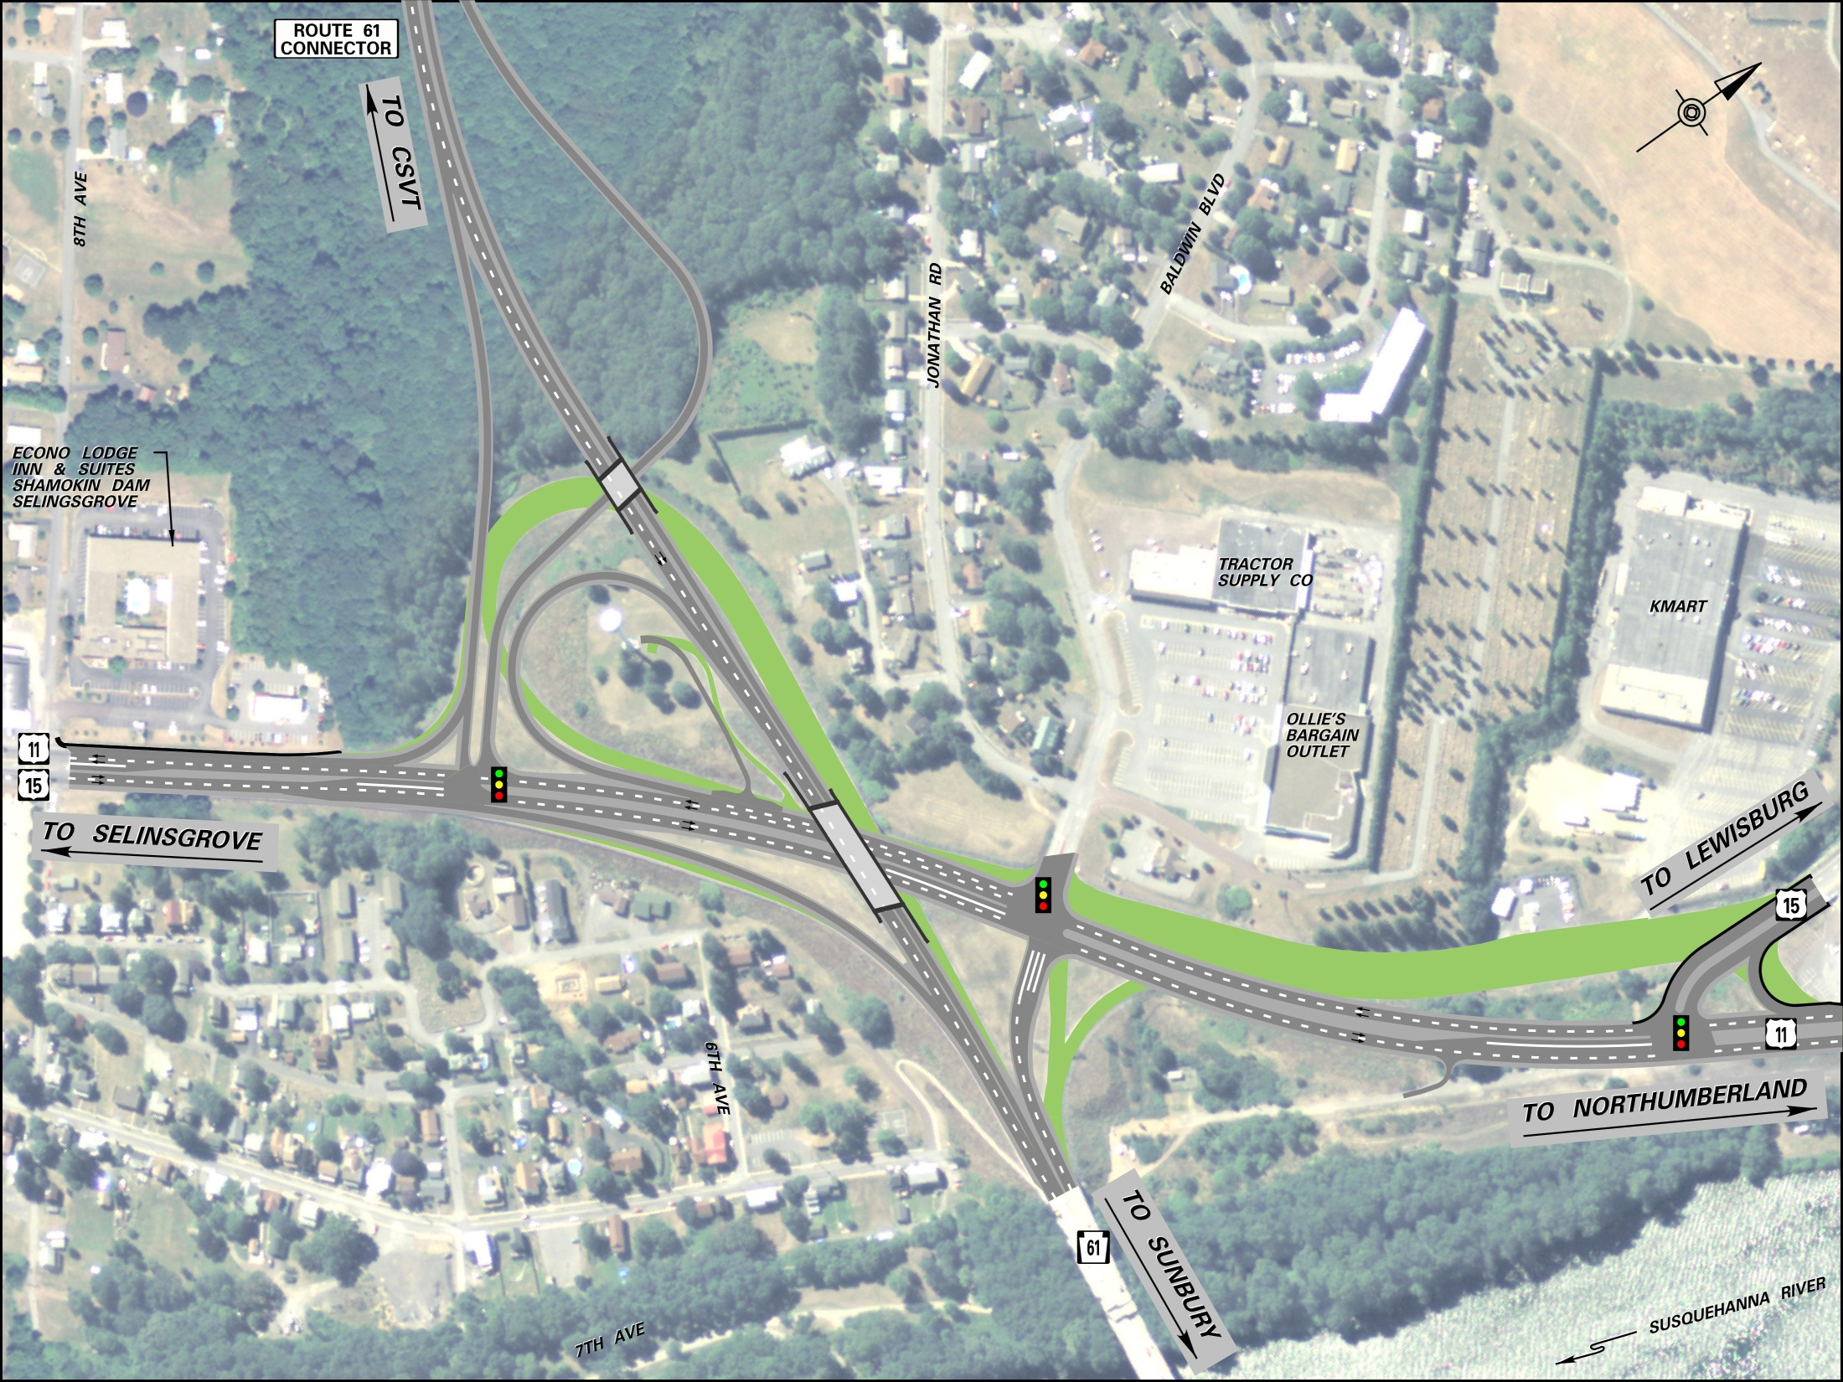
Shamokin Dam Interchange
Notes:
Interchange Movements
YELLOW - From 11/15 Gold Strip headed for Sunbury.
RED - From 11/15 each direction (Selinsgrove/Lewisburg/Northumberland) headed for CSVT.
BLUE - From CSVT headed for the strip/Lewisburg or Northumberland will use this ramp.
BLACK - From 11/15 South headed for Sunbury.
ORANGE - From Sunbury headed for CSVT
PURPLE - From Sunbury headed for the Golden Strip, Lewisburg or Northumberland on 11/15.

Slide 19
SR 15 SECTION 088 CSVT SOUTHERN SECTION
PROJECT SCHEDULE
Clear land
Earthwork
Drainage
Ultimate objective - contract documents and plans
Major components - roadway, bridges, soils, traffic, environmental
On-going process.
Approximately 30 parcels acquired; 60 parcels remain
Several utilities affected by CSVT
Examples; proposed UGI gas line, Aqua wells, PPL – ash basins and transmission/distribution.
Earth disturbance permit – PADEP, Snyder County Conservation District.
Permit for wetlands/waterways from PADEP and USACE.
Earthwork, bridges, paving, signals
Prior to starting construction
Report new and substantial impacts, applicable new laws/regulations, noteworthy changes in existing condition
Paving
Guiderail
Signs and Signals
Bridges

Slide 20
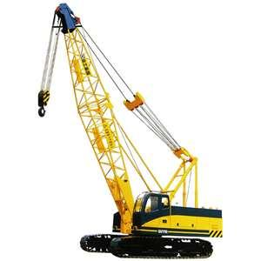
SR 15 SECTION 088 CSVT SOUTHERN SECTION
WHY SEPARATE CONSTRUCTION CONTRACTS?
More competitive bidding
Fits with anticipated funding levels
Through traffic on CSVT before Connector Construction

Slide 21
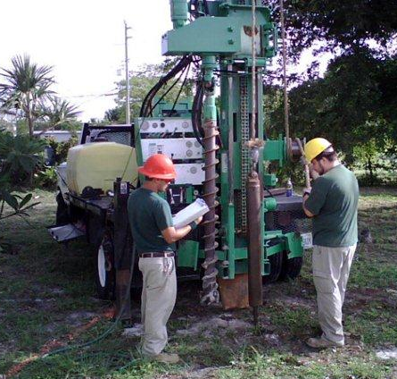
SR 15 SECTION 088 CSVT SOUTHERN SECTION
IMPACT TO THE PUBLIC DURING DESIGN AND CONSTRUCTION
Survey Crews
Soil Boring Crews
Traffic Control During Construction

Slide 22
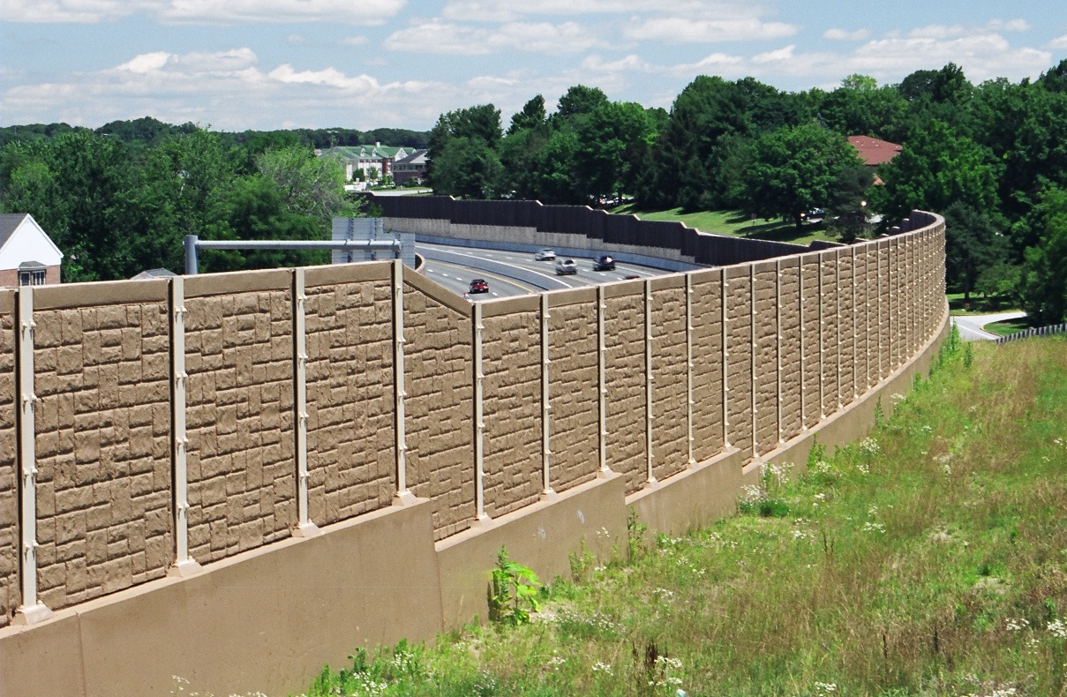
SR 15 SECTION 088 CSVT SOUTHERN SECTION
OTHER COORDINATION WITH PUBLIC
Public Meetings
Sound Barrier Coordination
Well Survey, Blasting Inspection
Right-of-Way Acquisition

Slide 23
SR 15 SECTION 088 CSVT SOUTHERN SECTION
WHAT IF MY LAND IS NEEDED?
“Just Compensation” = Fair Market Value + Other Benefits
PennDOT Right-of-Way Staff …
present tonight to answer questions
will personally contact every affected landowner at appropriate time to begin the process.

Slide 24
SR 15 SECTION 088 CSVT SOUTHERN SECTION
UPCOMING ACTIVITIES
Develop Alternatives – Now
Survey – Underway
Soil Borings – Beginning late Summer 2015
Subsurface Utility Engineering – Summer 2015

Slide 25
SR 15 SECTION 088 CSVT SOUTHERN SECTION
HOW DO I GET INFORMATION?
Attend Public Meetings
Visit Project Web Site – csvt.com
Contact PennDOT Project Manager
Maggie Jackson
margjackso@pa.gov
570-368-5672

Slide 26
SR 15 SECTION 088 CSVT SOUTHERN SECTION
OPEN DISCUSSION & GENERAL QUESTIONS

